Slide 1
Presentation project
Niels Vervoort, Cedric Schoeters

Slide 2
Project description
Running app
Website
Server

Slide 3
Extra function
Time input
Speech output

Slide 4
Description app
Login page
Activity page
Recording page
Statistics page
setting

Slide 5
Description site
Page general info
Login button
Activities page
Statistics page

Slide 6
Work breakdown structure
application weeks
Login 1 weeks
design 2 week
Timer, gps, route 3 weeks
User input estimated time 1 week
Speech feedback 2 weeks
Link to server 1 weeks
Graphical overview 2 weeks

Slide 7
wbs
2. Website
Design 3 weeks
Log in 1 week
Link to server 3 weeks
Graphical overview 5 weeks

Slide 8
wbs
3. Server
DDL 3 weeks
DML 1 week

Slide 9
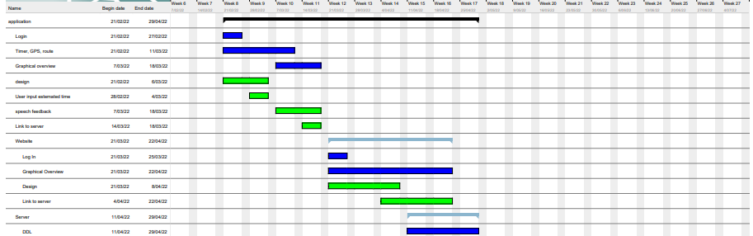
Gant chart

